Slide 1
Telangana Tourism Data Analysis.
Tools used:Python,SQL,Excel.
By,
LOHITH KUMAR A

Slide 2
Introduction to Telangana State
Telangana, India's 29th state, was formed on June 2, 2014, after being separated from Andhra Pradesh. Located in the southern region of India, Telangana has a rich cultural heritage, with Hyderabad as its capital and largest city. Known for its diverse culture, Telangana blends traditions from the Deccan region, with influences from Persian, Mughal, and Hindu cultures.
Key Facts:
Capital: Hyderabad
Formation Date: June 2, 2014
Official Language: Telugu, Urdu
Area: 112,077 square kilometers
Population: Over 35 million
Major Cities: Hyderabad, Warangal, Nizamabad, Karimnagar
Economy: Telangana's economy is driven by agriculture, information technology, and manufacturing. The state is one of the leading IT hubs in India, with Hyderabad being known as "Cyberabad" due to its thriving tech industry.

Slide 3
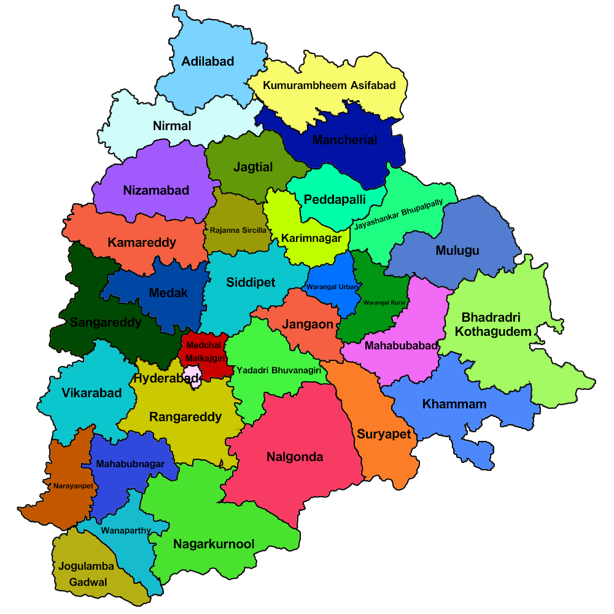
Districts.
The State comprises of 33 districts covering an area of 1,12,077 sq. km (44,273 sq. mi). The largest district is Bhadradri Kothagudem whereas Hyderabad is the smallest.

Slide 4
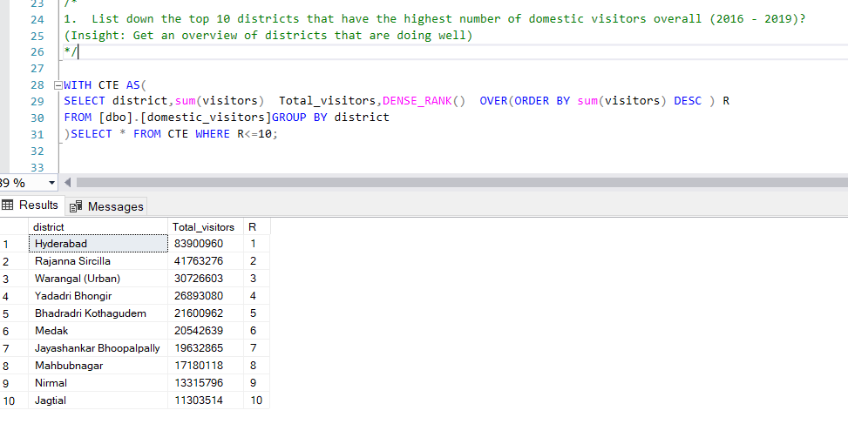
Insights For Telangana Government Tourism Department. 1.List down the top 10 districts that have the highest number of domestic visitors overall (2016 - 2019)?

Slide 5
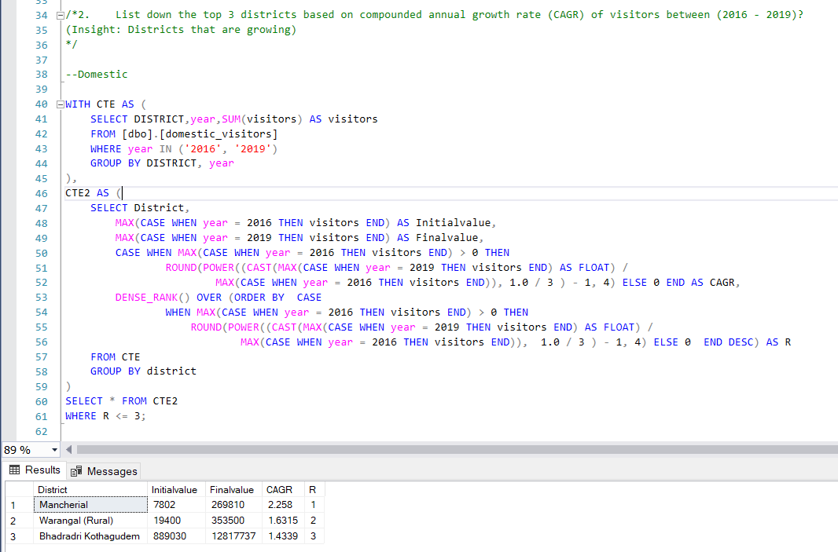
2.List down the top 3 districts based on compounded annual growth rate (CAGR) of visitors between (2016 - 2019)? ---Domestic

Slide 6
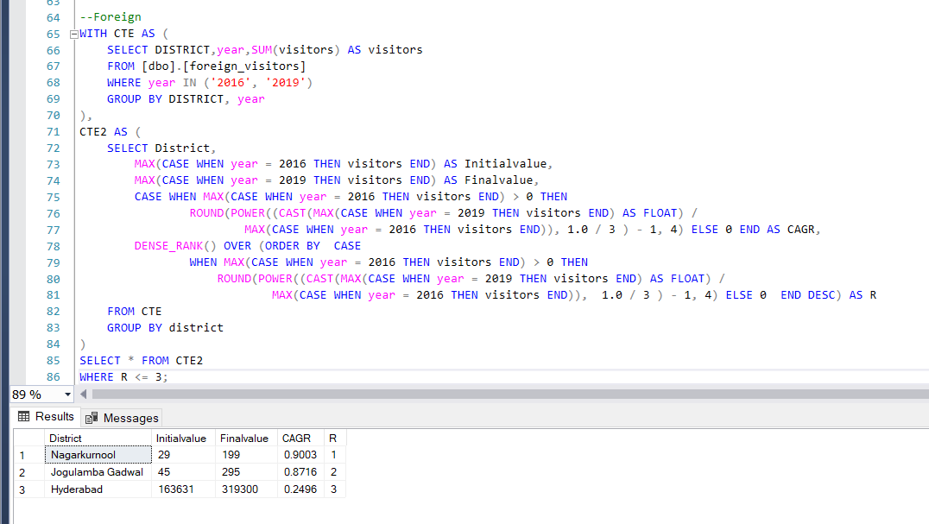
2.List down the top 3 districts based on compounded annual growth rate (CAGR) of visitors between (2016 - 2019)? ---Foreign

Slide 7
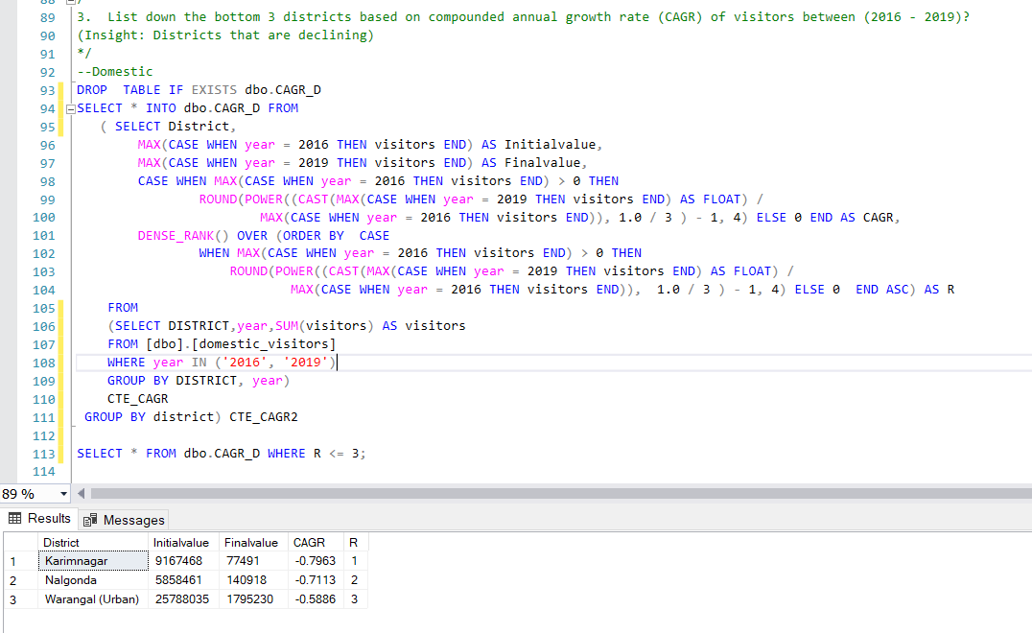
3.List down the bottom 3 districts based on compounded annual growth rate (CAGR) of visitors between (2016 - 2019)? ---Domestic

Slide 8
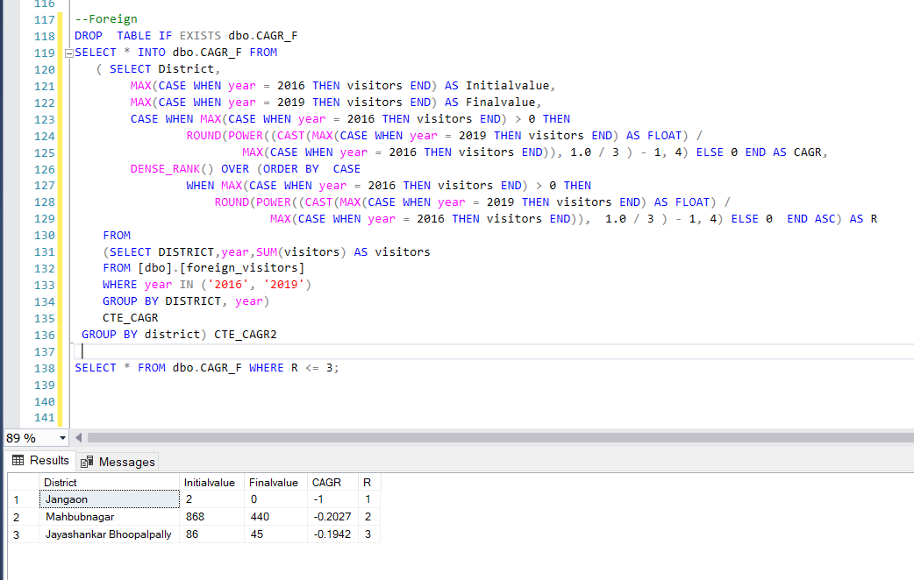
3.List down the bottom 3 districts based on compounded annual growth rate (CAGR) of visitors between (2016 - 2019)? ---Foreign

Slide 9
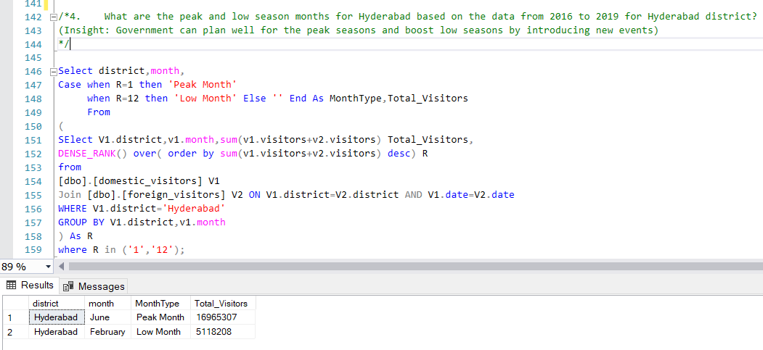
4.What are the peak and low season months for Hyderabad based on the data from 2016 to 2019 for Hyderabad district?

Slide 10
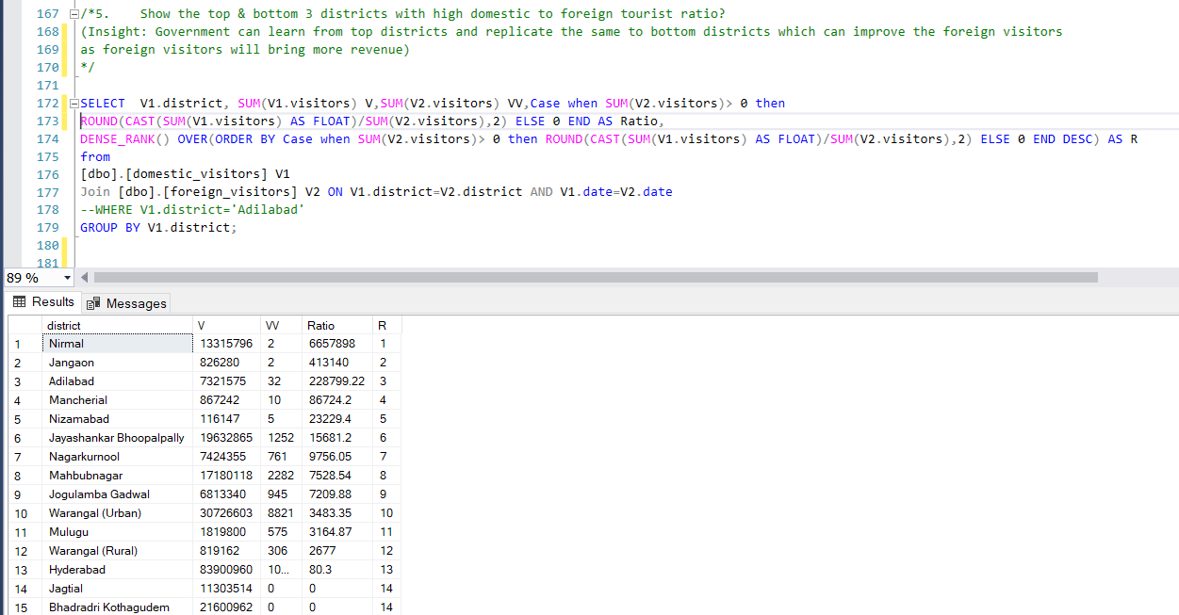
5.Show the top & bottom 3 districts with high domestic to foreign tourist ratio?

Slide 11
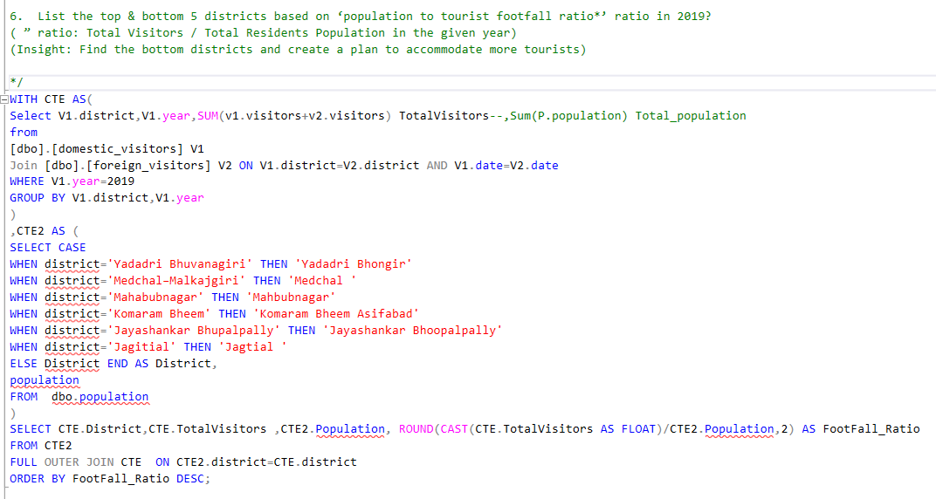
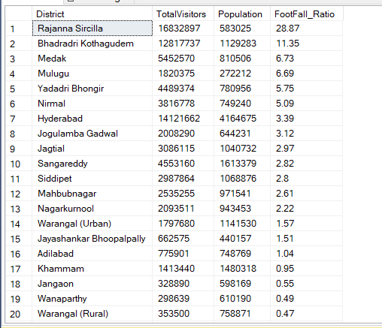
6.List the top & bottom 5 districts based on ‘population to tourist footfall ratio*’ ratio in 2019? ( ” ratio: Total Visitors / Total Residents Population in the given year)

Slide 12
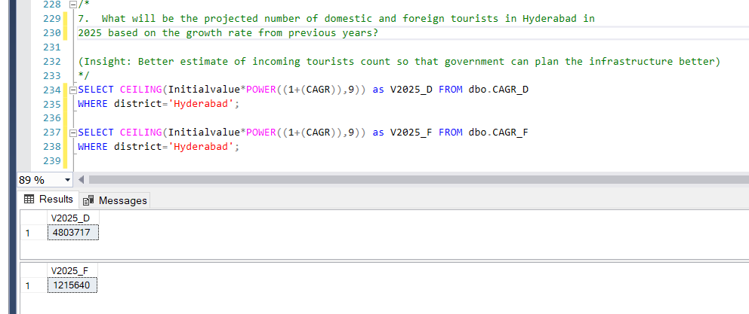
7.What will be the projected number of domestic and foreign tourists in Hyderabad in 2025 based on the growth rate from previous years?

Slide 13
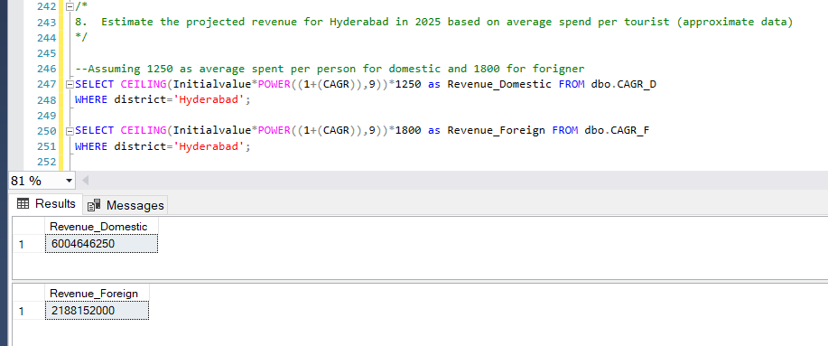
8.Estimate the projected revenue for Hyderabad in 2025 based on average spend per tourist (approximate data)

Slide 14
END

